Slide 1


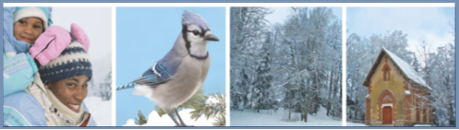
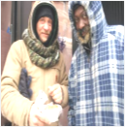
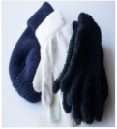

REDEEMING LOVE FAMILY CHURCH
Coat & Blanket Drive
Help keep someone warm this winter!
Simply bring gently used or new coats, blankets, hats, gloves and or scarves and place on the rack located in the rlfc foyer.
SEPTEMBER 30TH ~ OCTOBER 30TH
All items collected will go to benefit the homeless and orphans in our area.
Redeeming Love Family Church* 4525 Campground Road* Fayetteville, NC 28314* WWW.RLFC1.ORG

